Slide 1
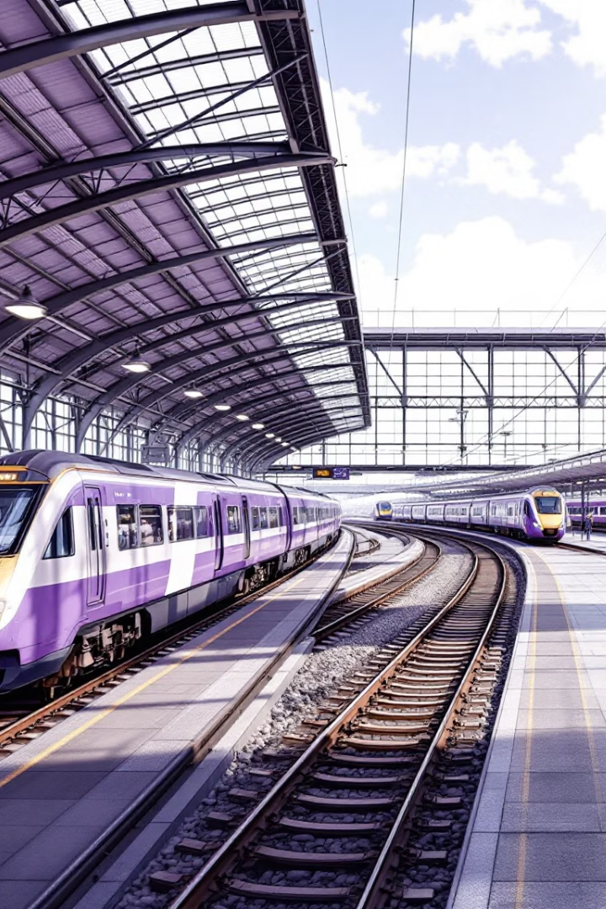


UK Train Rides
Acknowledgments
Thanks to Ministry of Communications and IT (DEPI)
Thanks to CLS Organization
Special thanks to Eng. Ahmed Hany
Program helped us gain skills in Data Analysis & Visualization.
GitHub - Noha-Essam/UK-Train-Rides: Dashboard Of UK-Train-Rides
UK-Train Dashboard

Slide 2
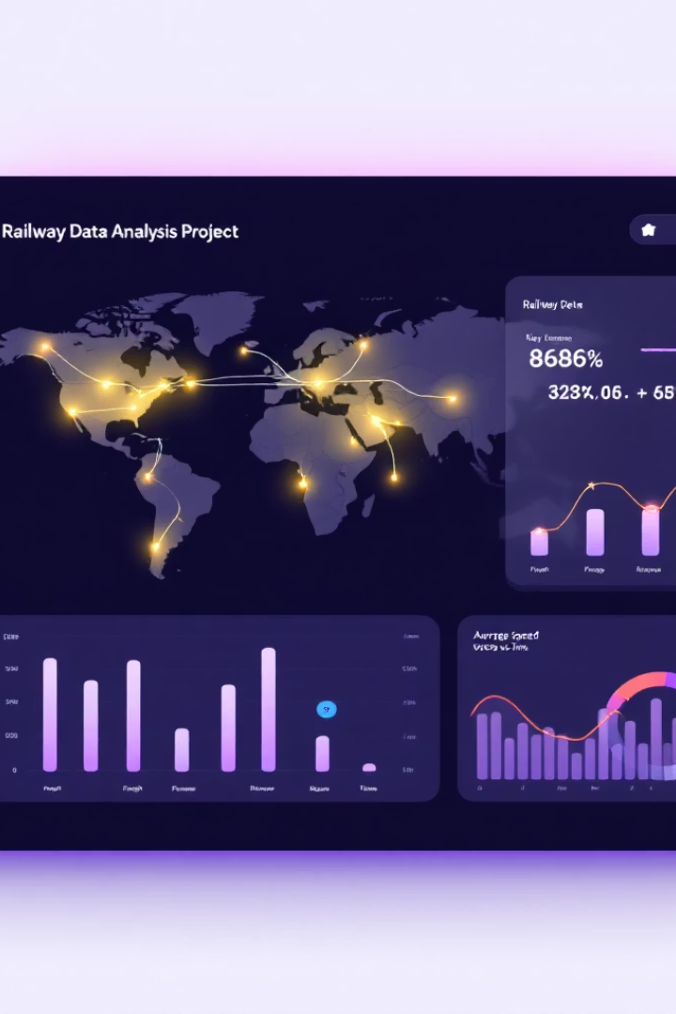
Project Introduction
Railway Data Analysis Project
Objective:
Generate actionable insights and interactive dashboards.
Identify key factors affecting train punctuality and reliability.
Analyze passenger satisfaction trends based on available data.
Provide recommendations for optimizing train operations and improving user experience

Slide 3





Project Life Cycle
DATA Discovering & Planning
GET DATA & Brainstorming
2
Data Source identification and Connection
1
ETL Process
3
DATA Modeling
5
Publishing and Sharing
Visualization
4
Dashboard Design

Slide 4
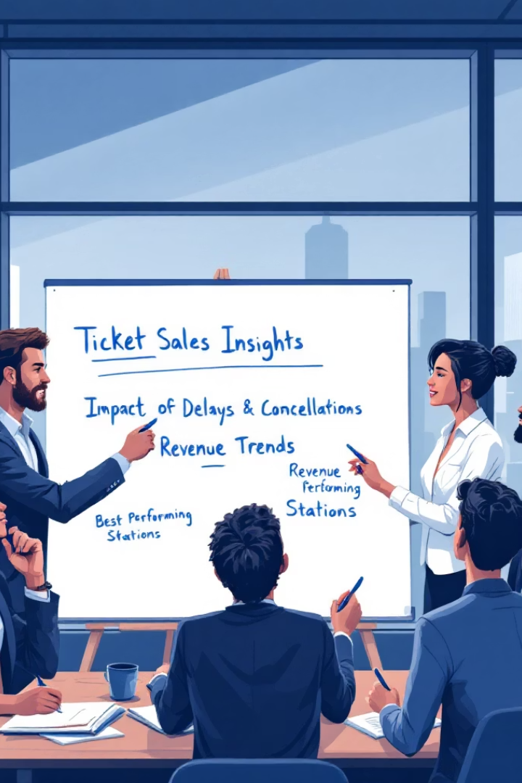
Brainstorming Stage
Key Questions:
Insights from ticket sales?
Impact of delays and cancellations?
Revenue trends?
Best performing stations?

Slide 5
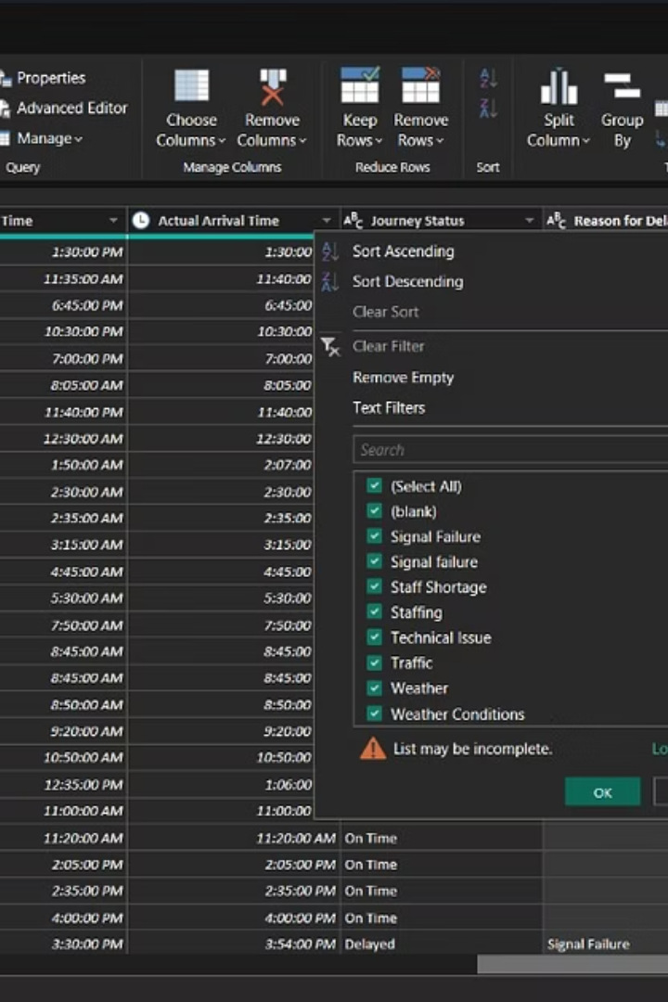
Data Discovery and Planning
Data Issues:
Duplicates
Wrong data types
Empty rows
Plan:
Clean & transform data
Divide tables
Build model
Design visuals

Slide 6
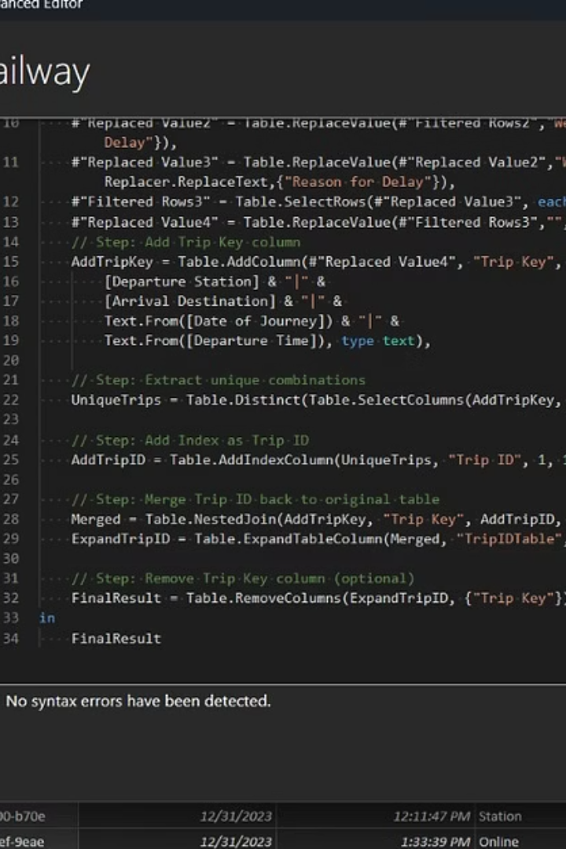
Data Cleaning and Transformation
Actions Taken:
Removed duplicates
Corrected data types
Handled empty rows
Created custom columns

Slide 7
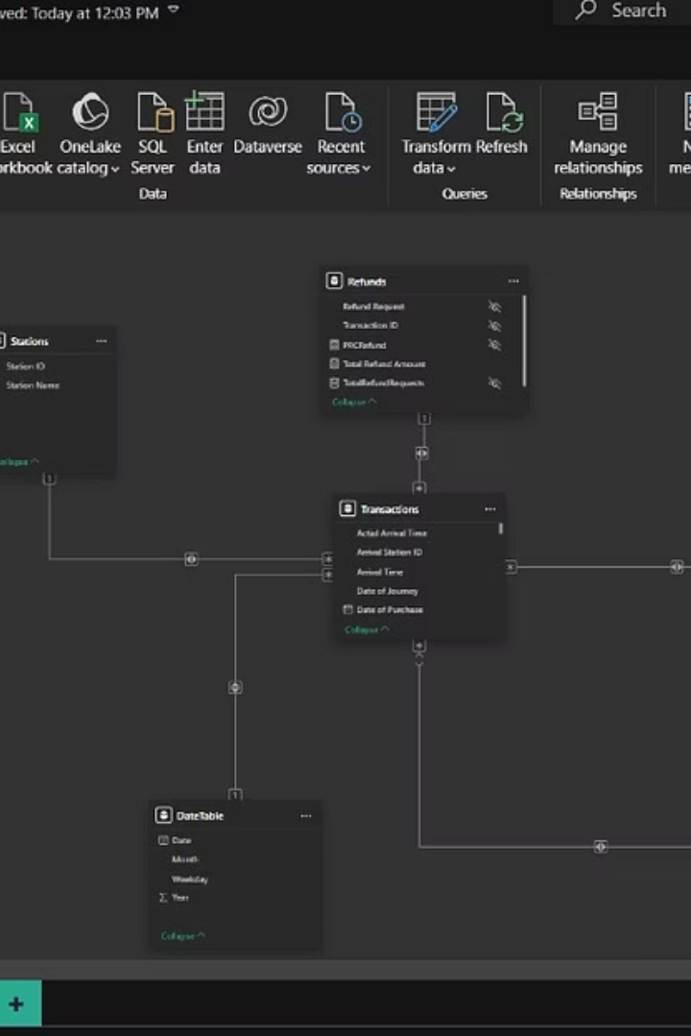
Data Dividing and Modeling
Structured into:
Transactions
Stations
Customers
Ticket Details
Refunds
Date Table
* Created clear relationships for performance

Slide 8
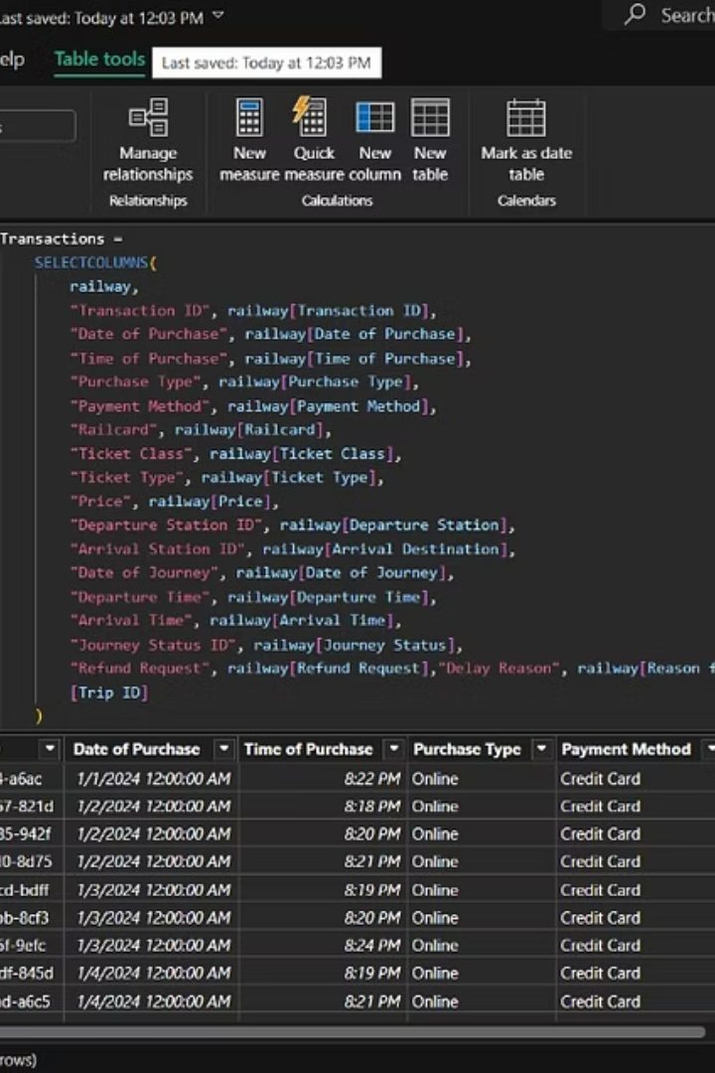
DAX Measures Creation
Developed DAX Measures:
Cancelled Journeys
Total Refund Amount
Revenue KPIs
Journey Performance Metrics

Slide 9
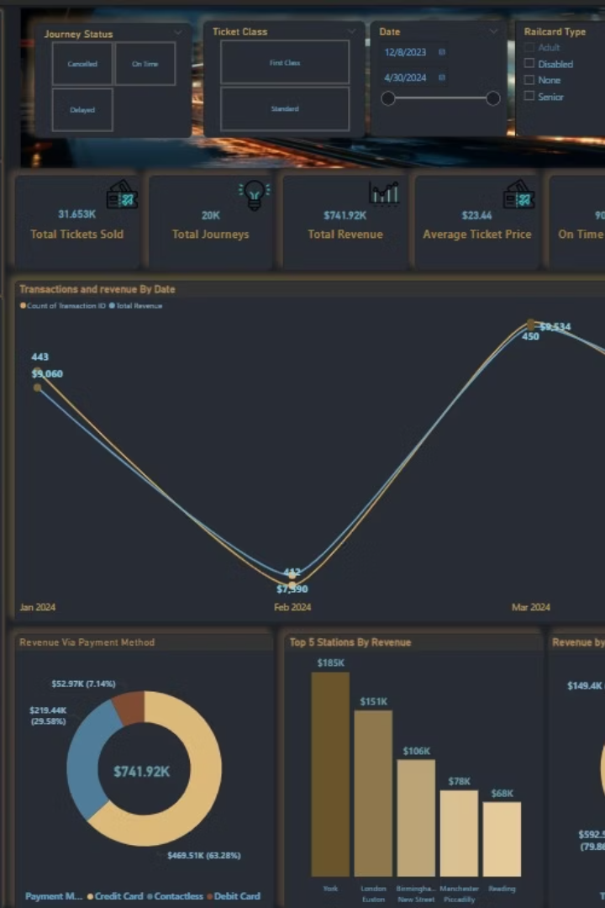
Dashboard - Overview Page
Key KPIs:
Total Revenue
Avg Ticket Price
Tickets Sold
Revenue by Class, Payment Method, Top Stations

Slide 10
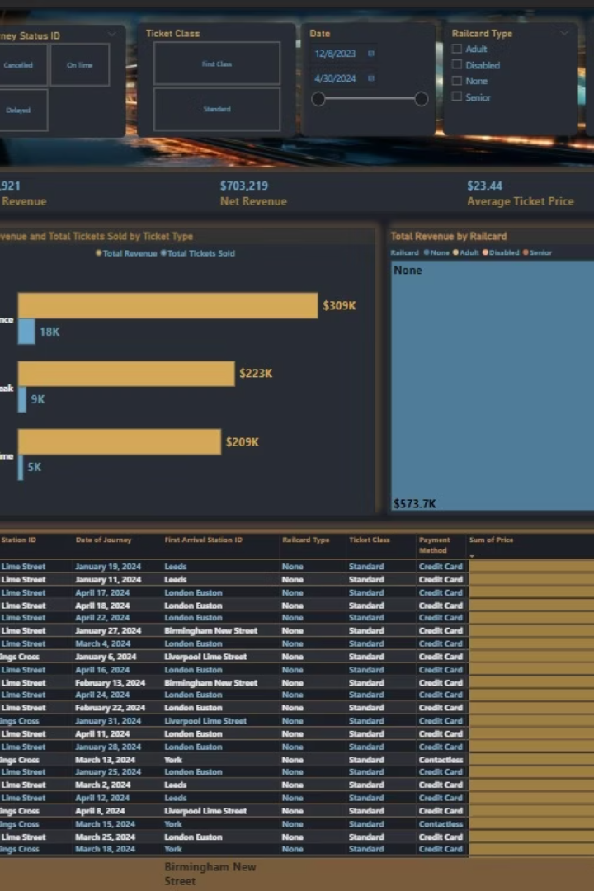
Dashboard - Sales Page
Sales Deep Dive:
Revenue by Ticket Type
Top Stations
Filters for Ticket Class, Railcard , Station

Slide 11
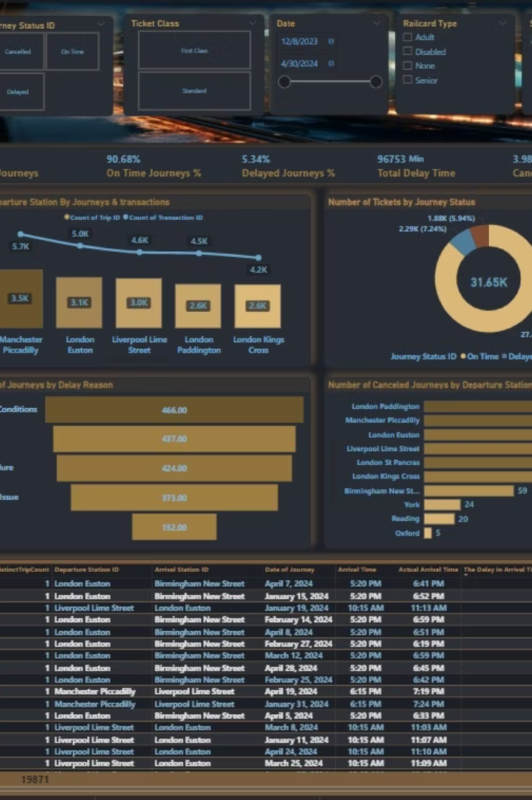
Dashboard - Journey Performance Page
Journey Status Insights:
On Time / Delayed / Cancelled
Delay reasons analysis

Slide 12
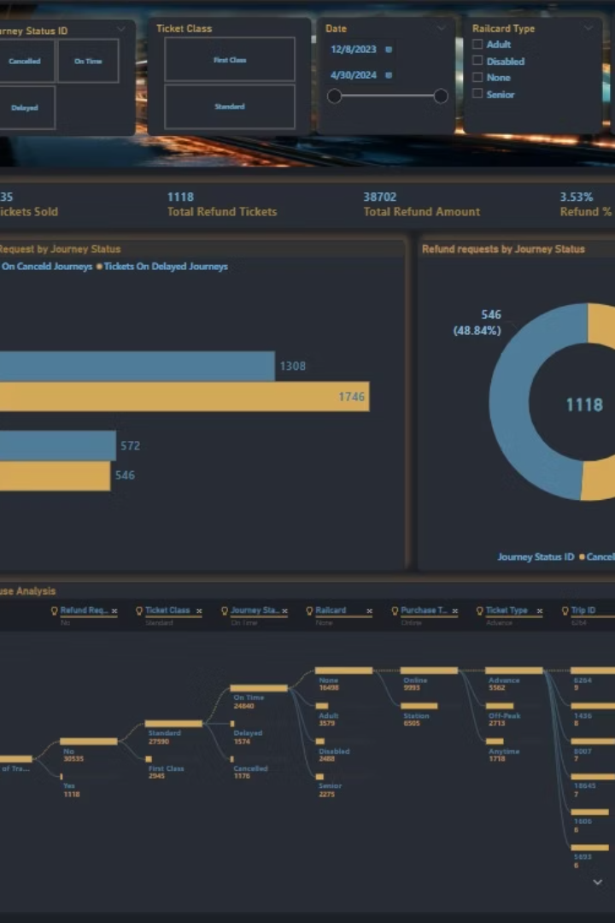
Dashboard - Refund Page
Refund Analysis:
Requests by journey status
Refund % of total tickets
Refund amounts

Slide 13
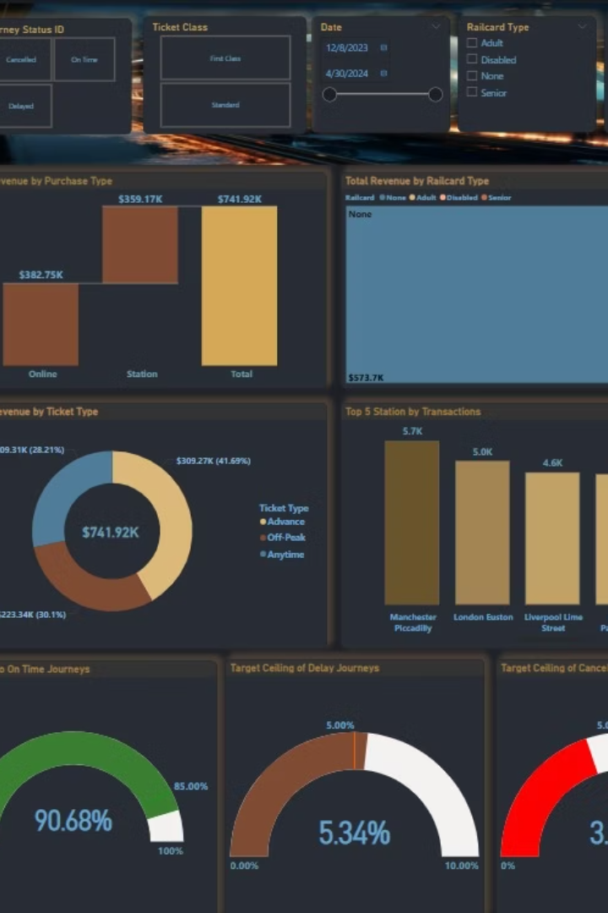
Dashboard - Customers Page
Customer Segmentation:
Ticket Type
Purchase Method
Railcard Type
Revenue contribution

Slide 14
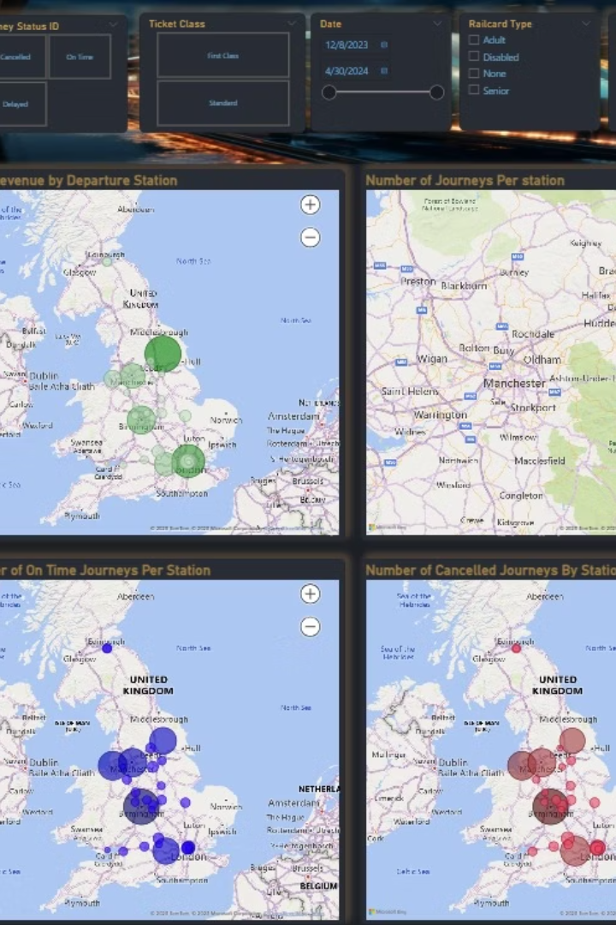
Dashboard - Geographic Page
Interactive Maps:
Journeys by Station
Revenue by Departure
On-time / Cancelled visual distribution

Slide 15
Actionable Recommendations
Improve Delay Handling
Why?
Some routes experience exceptionally high average delays (>500 minutes), which negatively impacts customer satisfaction and trust.
Action:
Focus on these critical routes to improve efficiency. Prioritize addressing signal failures and staffing shortages by coordinating closely with operations teams.
Boost Digital Sales
Why?
Online purchases slightly outperform station-based purchases, suggesting a user preference for digital convenience.
Action:
Launch targeted promotional offers and incentives for digital channels to further increase online adoption and reduce operational costs at physical stations.
Enhance Railcard Adoption
Why?
77% of revenue comes from users without railcards indicating untapped potential in discounts and loyalty.
Action:
Design marketing campaigns to encourage railcard adoption among seniors, disabled passengers, and frequent travelers to improve margins and customer retention.
Reduce Cancellation Rate
Why?
Cancellation rates are high in specific locations such as London Paddington and Manchester Piccadilly, potentially due to infrastructure or scheduling issues.
Action:
Conduct a detailed investigation into these high-cancellation zones and collaborate with station managers to enhance reliability and infrastructure quality.
Optimize Refund Experience
Why?
Only a portion of customers request refunds after cancellations, which may indicate an unclear or inefficient process.
Action:
Increase transparency around refund policies and streamline the claims process through automation and clearer communication channels.

Slide 16






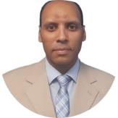

Meet Our Team
Noha Essam
Sara Sharaf
Shahenda Khaled
Mohamed Mostafa
Amir Ahmed

Slide 17

Thank You
*We appreciate your time and attention.

